Slide 1
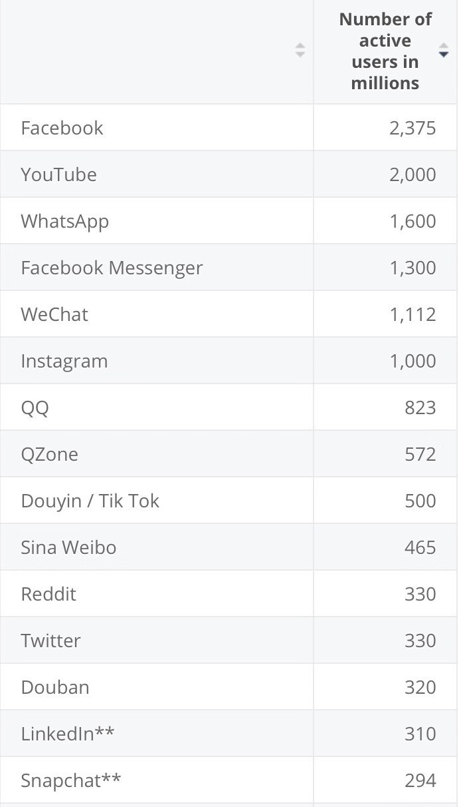
This statistic provides information on the most popular networks worldwide as of July 2019, ranked by number of monthly active accounts.

Slide 2
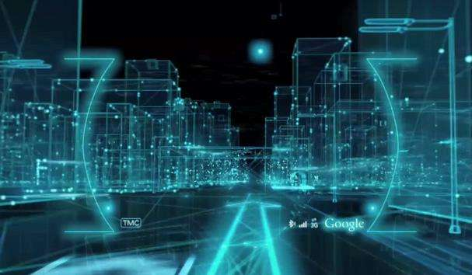
Digital:
数字化传媒改变了以往受众收听收看广播电视必须同步性的特点，而实现了异步性，即受众在任意选定的时间 进行收听收看，如有兴趣有必要可以反复收听收看；数字化传媒改变了以往媒体信息受控严格的局面，使信息的传播流通更为自由，尤其 是互联网通过其各种强大的功能，形成了海量信息源；数字化传媒改 变了以往众多媒体地域性传播的特 点，使传播的范围扩大至全球，它是推动全球化的强有力因素(
Digital media has changed the characteristics of the audience's need to listen to the radio and television synchronously,that is the audience listen to the radio and watch the program at any selected time.If they are interested, they can listen to it repeatedly.
Digital media has changed the characteristics of regional media transmission in the past and made the scope of communication. Expanding to the world, it is a powerful factor driving globalization)

Slide 3
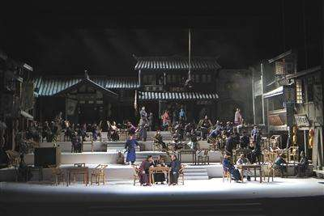

传播语境的“碎片化”:
有研究表明，当一个社会的人均收入在1000-3000美元时，这个社会处在由传统社会向现代社会的过渡期，这个过渡期的一个基本特征就是社会的“碎片化”:
传统的社会关系、市场结构及社会观念的整一性———从精神家园到信用体系，从话语方式到消费模式——瓦解了，代之以一个一个利益族群和“文化部落”的差异化诉求及社会成分的碎片化分割。因此，就传播的影响力而言，以往依靠某一个（类）媒介的强势覆盖而“号令天下”的时代已经一去不复返了。
("fragmentation" of the context of communication:
Studies have shown that when a society's per capita income is between 1,000 and 3,000 US dollars, this society is in the transition period from traditional society to modern society. A basic feature of this transitional period is the “fragmentation” of society: traditional social relations. The uniformity of market structure and social concept—from spiritual home to credit system, from discourse to consumption mode—disintegrates, replaced by a different interest group and “cultural tribe”. Fragmentation of the segmentation. Therefore, in terms of the influence of communication, the era of relying on the strong coverage of a certain (class) medium and “ordering the world” has gone forever.)

Slide 4
话语权的阅众分享
我们是在一个高度中心化的世界里成长的，信息的社会化传播以及“话语权”一直是少数人享有的
“专利”。受众，在过去的传播学词典中始终是传播链条中下游角色的一个专属名词，其能动性至多不过表现为选择或者不选择某个传媒，接受或者不接受某项传播内容或形式。但目前传播领域发生的真正重大事变，乃是“上游”角色成分的深刻变化。
(Discourse sharing
We are growing up in a highly centralized world. The socialization of information and the “discourse power” have always been the “patents” enjoyed by a few people. The audience, in the past communication dictionary, has always been a special term for the middle and lower reaches of the chain. Its dynamism is at best characterized by choosing or not choosing a media, accepting or not accepting a certain content or form. However, the real major event in the field of communication is the profound change in the role of the "upstream" role.)

Slide 5


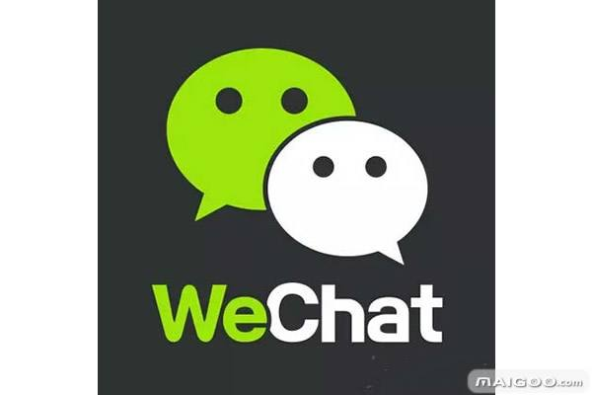





Advantages:
1.传播双向化( info spreading way changes from one-way to two-way )
what if you want to comment on the article published in the newspaper or some social hot events repoirt?
1. write letters to newspaper
2.Call the audience hotline
3.speak with your friends
4...
What's thing going on when it comes to new media?
1.register public accounts
2.
3.answer questions
4.
)

Slide 6
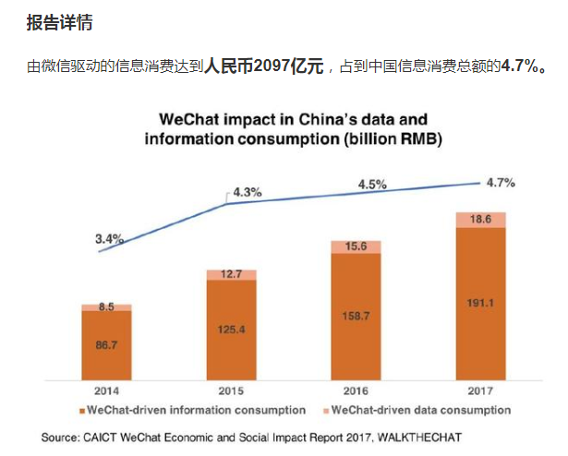
根据微信数据，公众号的注册总量已经超过2000万个，截至2017年9月，活跃的公众号数量为350万个。

Slide 7
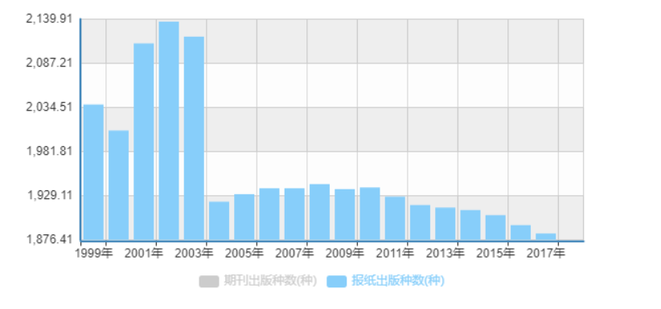

Slide 8
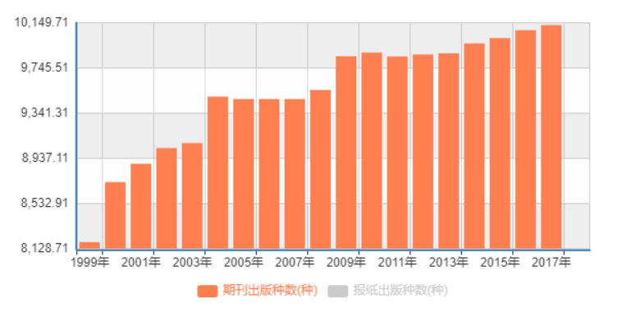

Slide 9
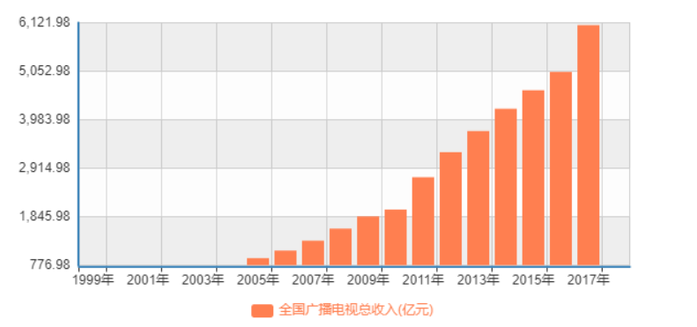

Slide 10
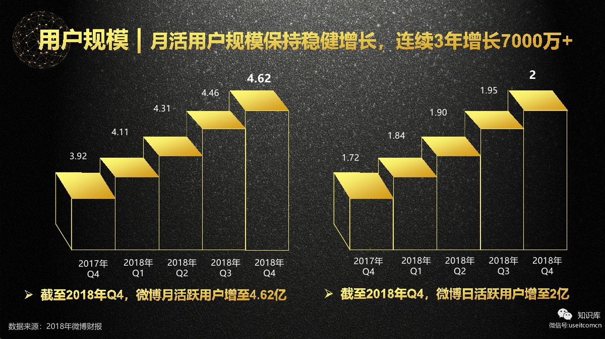

Slide 11
虎牙直播:
极光大数据发布的《2018年3月直播app行业研究报告》显示，截至2018年2月，直播app用户规模超过2.2亿人，市场渗透率最高的三款直播app分别是斗鱼直播、虎牙直播和YY，于17年12月24日上线的冲顶大会以1.03%的市场渗透率跻身top 10。

Slide 12
Disadvantages:
原创度不够
信息选择困难()
内容可信度，权威度不够
传播内容多元化

